Slide 1
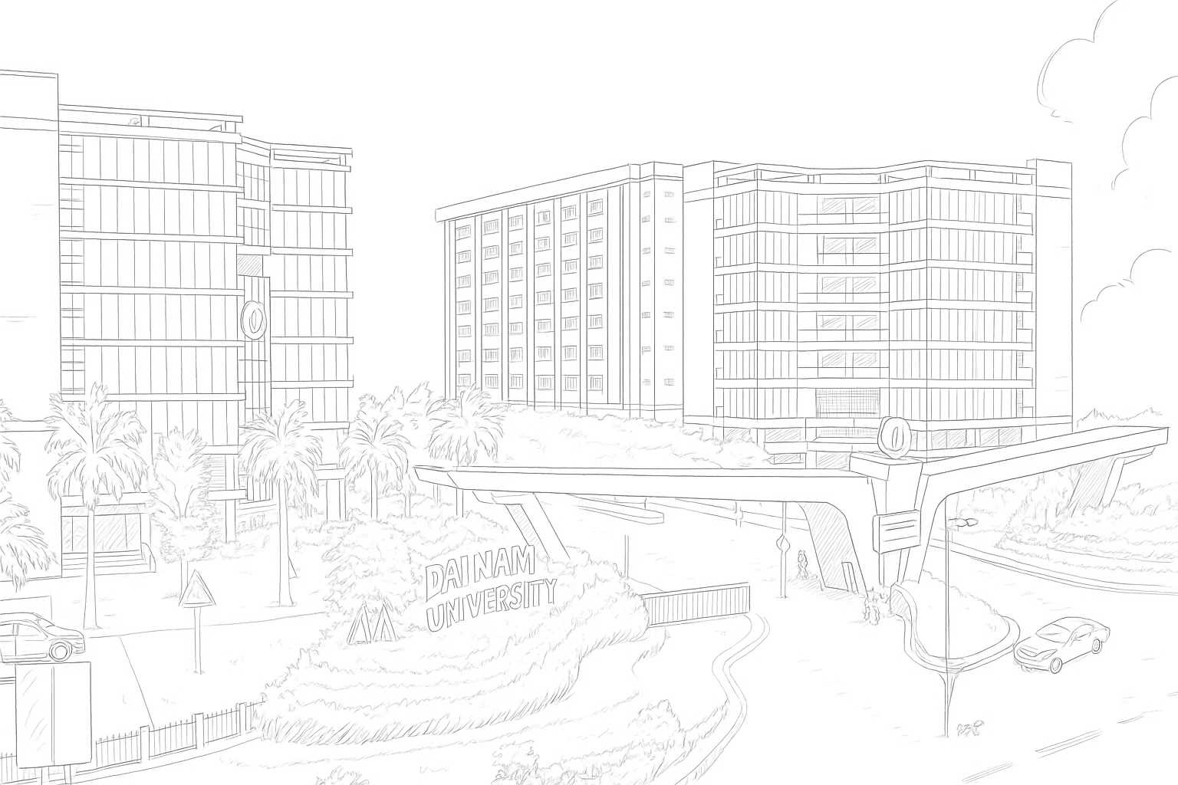


Systematic Evaluation of YOLO
in Student Behavior Detection - a New Dataset
Anh-Tu Tran¹, Thai Khanh Nguyen^{1, 2}, Trung Thanh Nguyen¹,
Tuan Anh Ha¹, Trung Hieu Le¹
¹ Dai Nam University
² Ha Noi University of Science and Technology
FIT-DNU
Dainam University

Slide 2

CÔNG TÁC ĐÁNH GIÁ THỰC TẬP
CONTENTS
1. INTRODUCTION
2. RELATED WORKS
3. CONTRIBUTIONS
4. CONCLUSIONS AND FUTURE WORKS

Slide 3
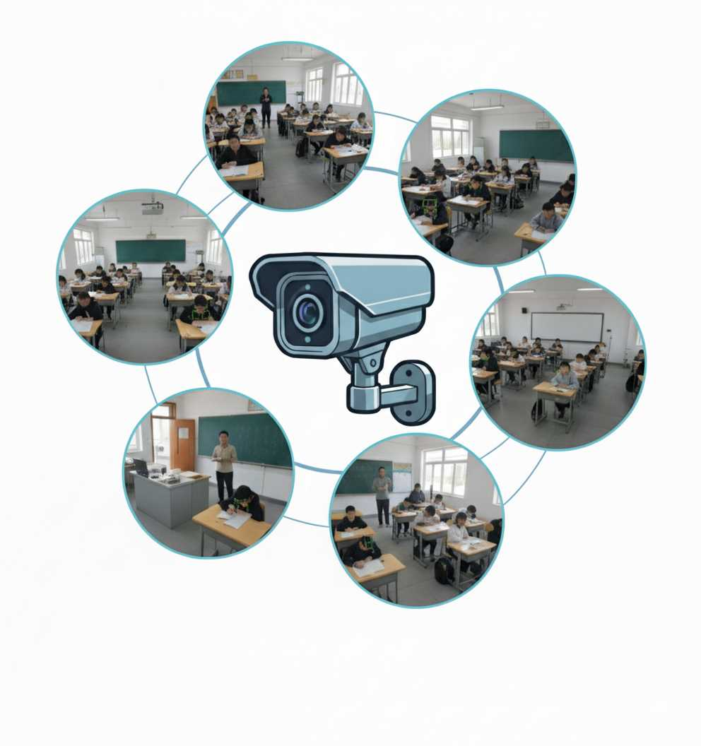
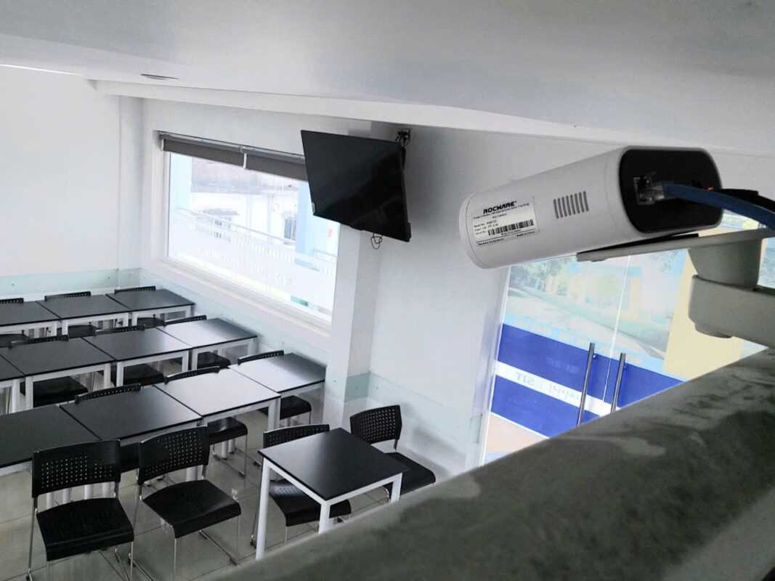
CÔNG TÁC ĐÁNH GIÁ THỰC TẬP
INTRODUCTION
Educational quality evaluation = crucial for improvement
Traditional approaches are no longer highly effective:
Not suitable for large classes
Time consuming
Affected by external factors
Dependent on personal perspectives
Camera have become increasingly cammon in classrooms → Providing a valuable source of data
This study introduces a new dataset and evaluates YOLO models to demonstrate the feasibility of real time deployment.

Slide 4
CÔNG TÁC ĐÁNH GIÁ THỰC TẬP
RELATED WORKS
92.86% acc,
5 student behaviors,
Faster R-CNN + OpenPose + CNN
[2019, Fu]
79.4% acc,
not/understanding
VGG-16 transfer learning
[2021, Ben]
95.2% mAP,
YOLOv3,
posture recognition
[2023, Nazaruddin]
WAD-YOLOv8 , +5.5% mAP, multi-dataset [2025, Han]
YOLO-CBD, 93.4% mAP,
focus & distract [2025, Peng]
72% acc,
6 gestures
Classroom 2.0,
PTZ camera
[2011, Fang]
89.8% mAP,
4 behaviors,
YOLOv5++ ,
[2022, Tang]
hand-raising, standing, sleeping
Faster R-CNN++
[2020, Zheng]
YOLOv5-A + OpenPose,
82.1% mAP,
5 behaviors
[2024, Jia]
YOLOv5s++ , +8.6% AP,
8 behaviors [2025, Liang]
2011
2019
2020
2021
2022
2023
2024
2025
Year

Slide 5
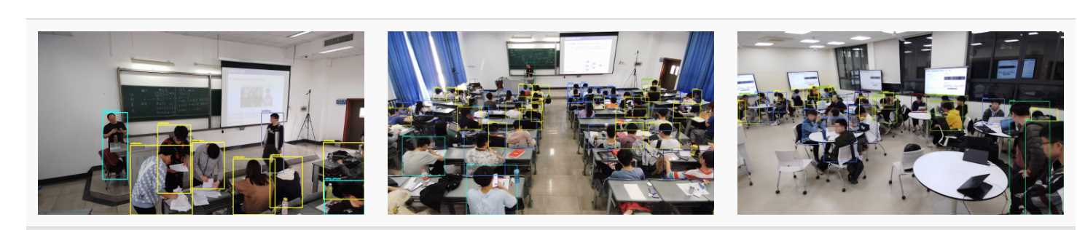
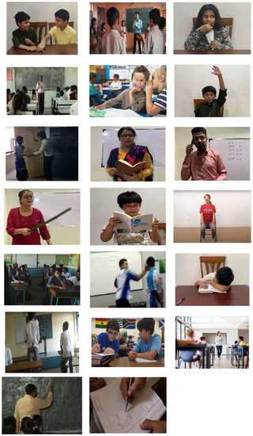
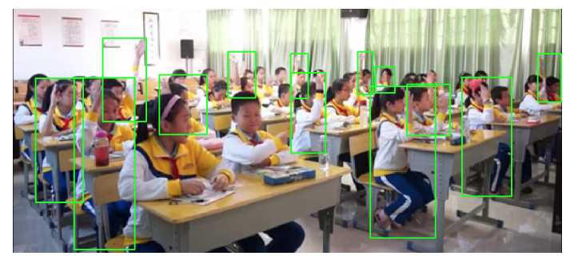
CÔNG TÁC ĐÁNH GIÁ THỰC TẬP
DATASET
RELATED WORKS
[Xu, 2024]: 36,453 images, 32 action categories, collected from real-world classroom environments.
[Sharma, 2021]: 7,851 short clips, 20 classroom actions, collected from YouTube and real world classrooms.
[Fan, 2023]: 7,428 images, 20 behavior classes, collected from real classroom environments.

Slide 6
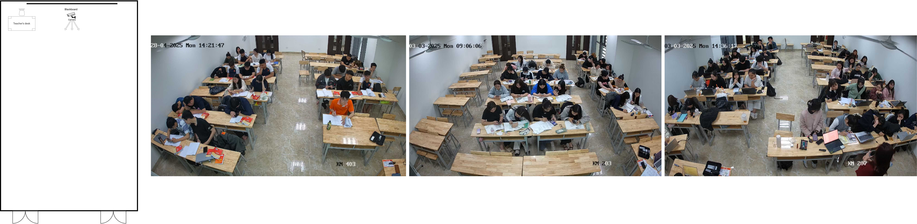
T-STUDENTS FITDNU DATASET
CÔNG TÁC ĐÁNH GIÁ THỰC TẬP
CONTRIBUTIONS
The Data were recorded by a single fixed-angle camera in three real classrooms at Dai Nam University.
Annotation Method → Semi-automatic annotation using Roboflow (manual seed set + YOLOv12 pre-labeling + correction)
Final dataset: 3,351 images and 126,429 bounding boxes across 9 classes.
Students per class: 23–35; Sessions: Three real university classes (~50 minutes each)

Slide 7
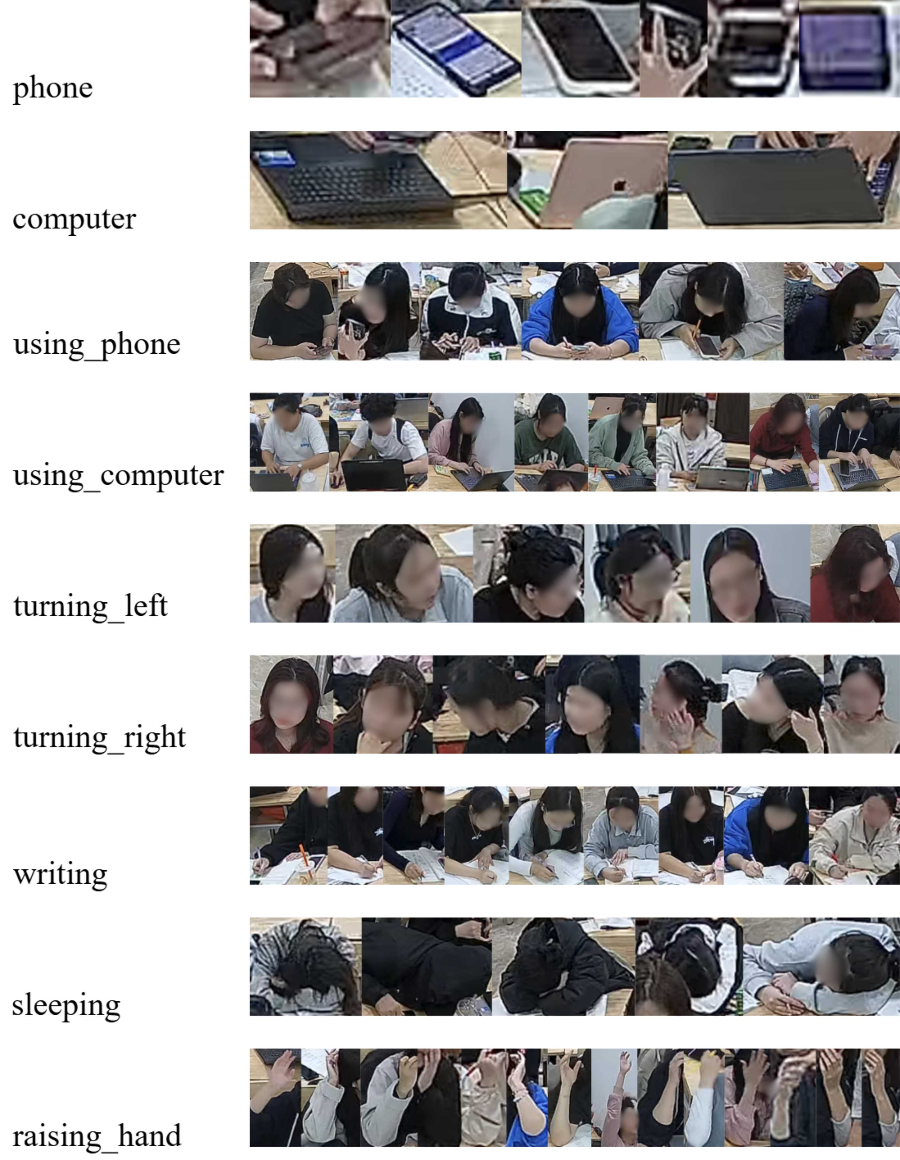
CÔNG TÁC ĐÁNH GIÁ THỰC TẬP
CONTRIBUTIONS
Characteristics of T-Students FITDNU:
Recorded in real classrooms
Class name | Average size (w x h) | Number of samples
phone | 11 x 17 | 45.910
computer | 34 x 55 | 20.100
using_phone | 38 x 82 | 23.709
using_computer | 46 x 101 | 8.412
turning_left | 33 x 58 | 9.720
turning_right | 31 x 56 | 9.222
writing | 38 x 83 | 4.212
sleeping | 38 x 55 | 4.826
raising_hand | 20 x 63 | 318
Bounding box size varies
Large occlusion in scenes
Multiple activities per frame

Slide 8
CÔNG TÁC ĐÁNH GIÁ THỰC TẬP
CONTRIBUTIONS
Comparison with Existing Datasets:
StudentAct → scripted, multi-camera
Dataset | T-Students FITDNU | StudentAct | SCB-Dataset3
Number of images | 3,351 | 31,046 | 5,686
Number of boxes | 126,429 | 596,371 | 45,578
Class types | 9 (7 behaviors + 2 objects) | 5 behaviors | 6 behaviors
Camera setup | Single fixed ceiling camera | Five synchronized cameras | Not specified
Annotation method | Manual + semi-auto (YOLOv12) | Manual + interpolation | Fully manual
Collection context | Real university classrooms (non-scripted) | Scripted multi-view sessions | School scenes
Key challenges | Small objects, occlusion, multi-label | View fusion, motion blur | Subtle postures, limited scale
SCB-Dataset3 → natural classrooms, few behaviors, no object labels
FITDNU → real classrooms, single camera, behavior + object labels, multi-label & occlusion challenges

Slide 9
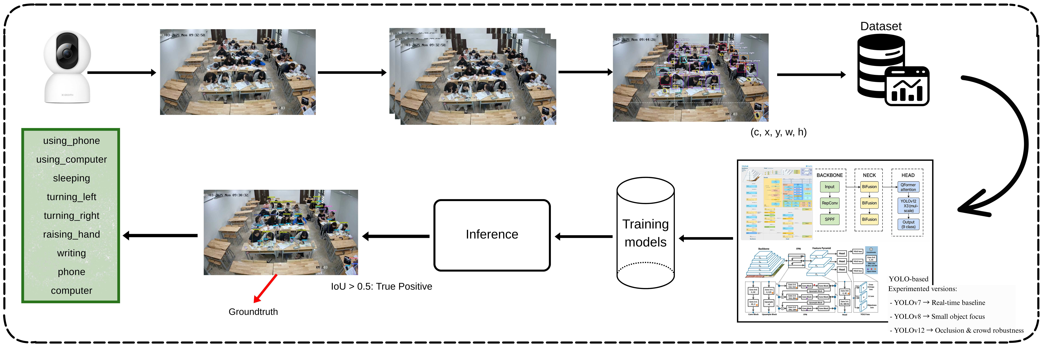
CÔNG TÁC ĐÁNH GIÁ THỰC TẬP
CONTRIBUTIONS

Slide 10
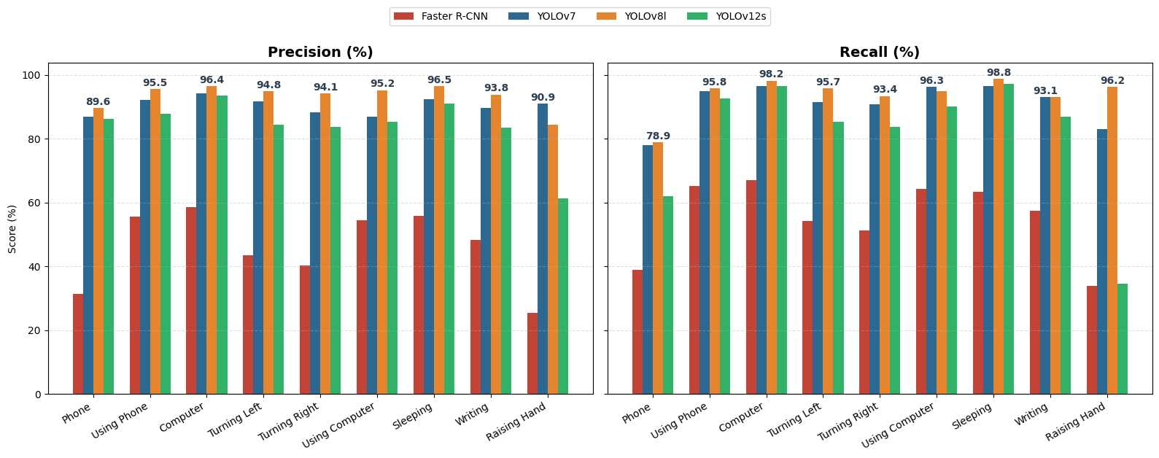
CÔNG TÁC ĐÁNH GIÁ THỰC TẬP
CONTRIBUTIONS
Detection Accuracy
YOLOv8l achieves the highest precision and recall across most behavior classes.
YOLOv7 remains competitive but shows lower recall in some actions.
YOLOv12s is less consistent, especially for small or overlapping objects.
Faster R-CNN performs poorly, confirming its limitation for classroom scenarios.

Slide 11
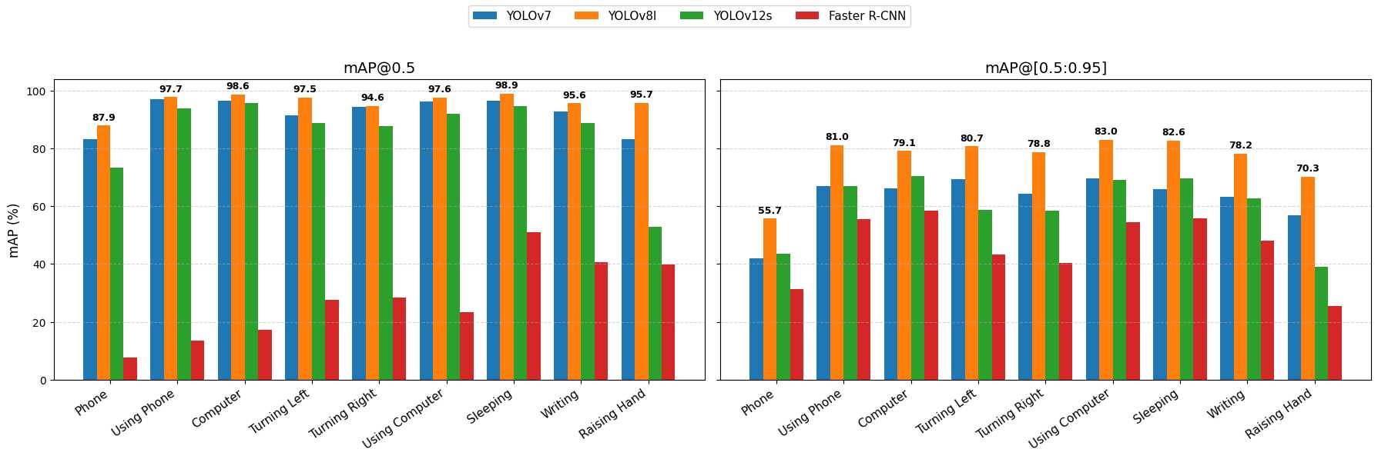
CÔNG TÁC ĐÁNH GIÁ THỰC TẬP
CONTRIBUTIONS
Detection Performance
YOLOv8l consistently outperforms all models across behaviors.
YOLOv7 remains competitive but less robust at higher IoU.
YOLOv12s shows instability, good in some classes but poor in small
Faster R-CNN lags far behind, unsuitable for this task.
YOLOv8l is an excellent choice for real-time applications.

Slide 12
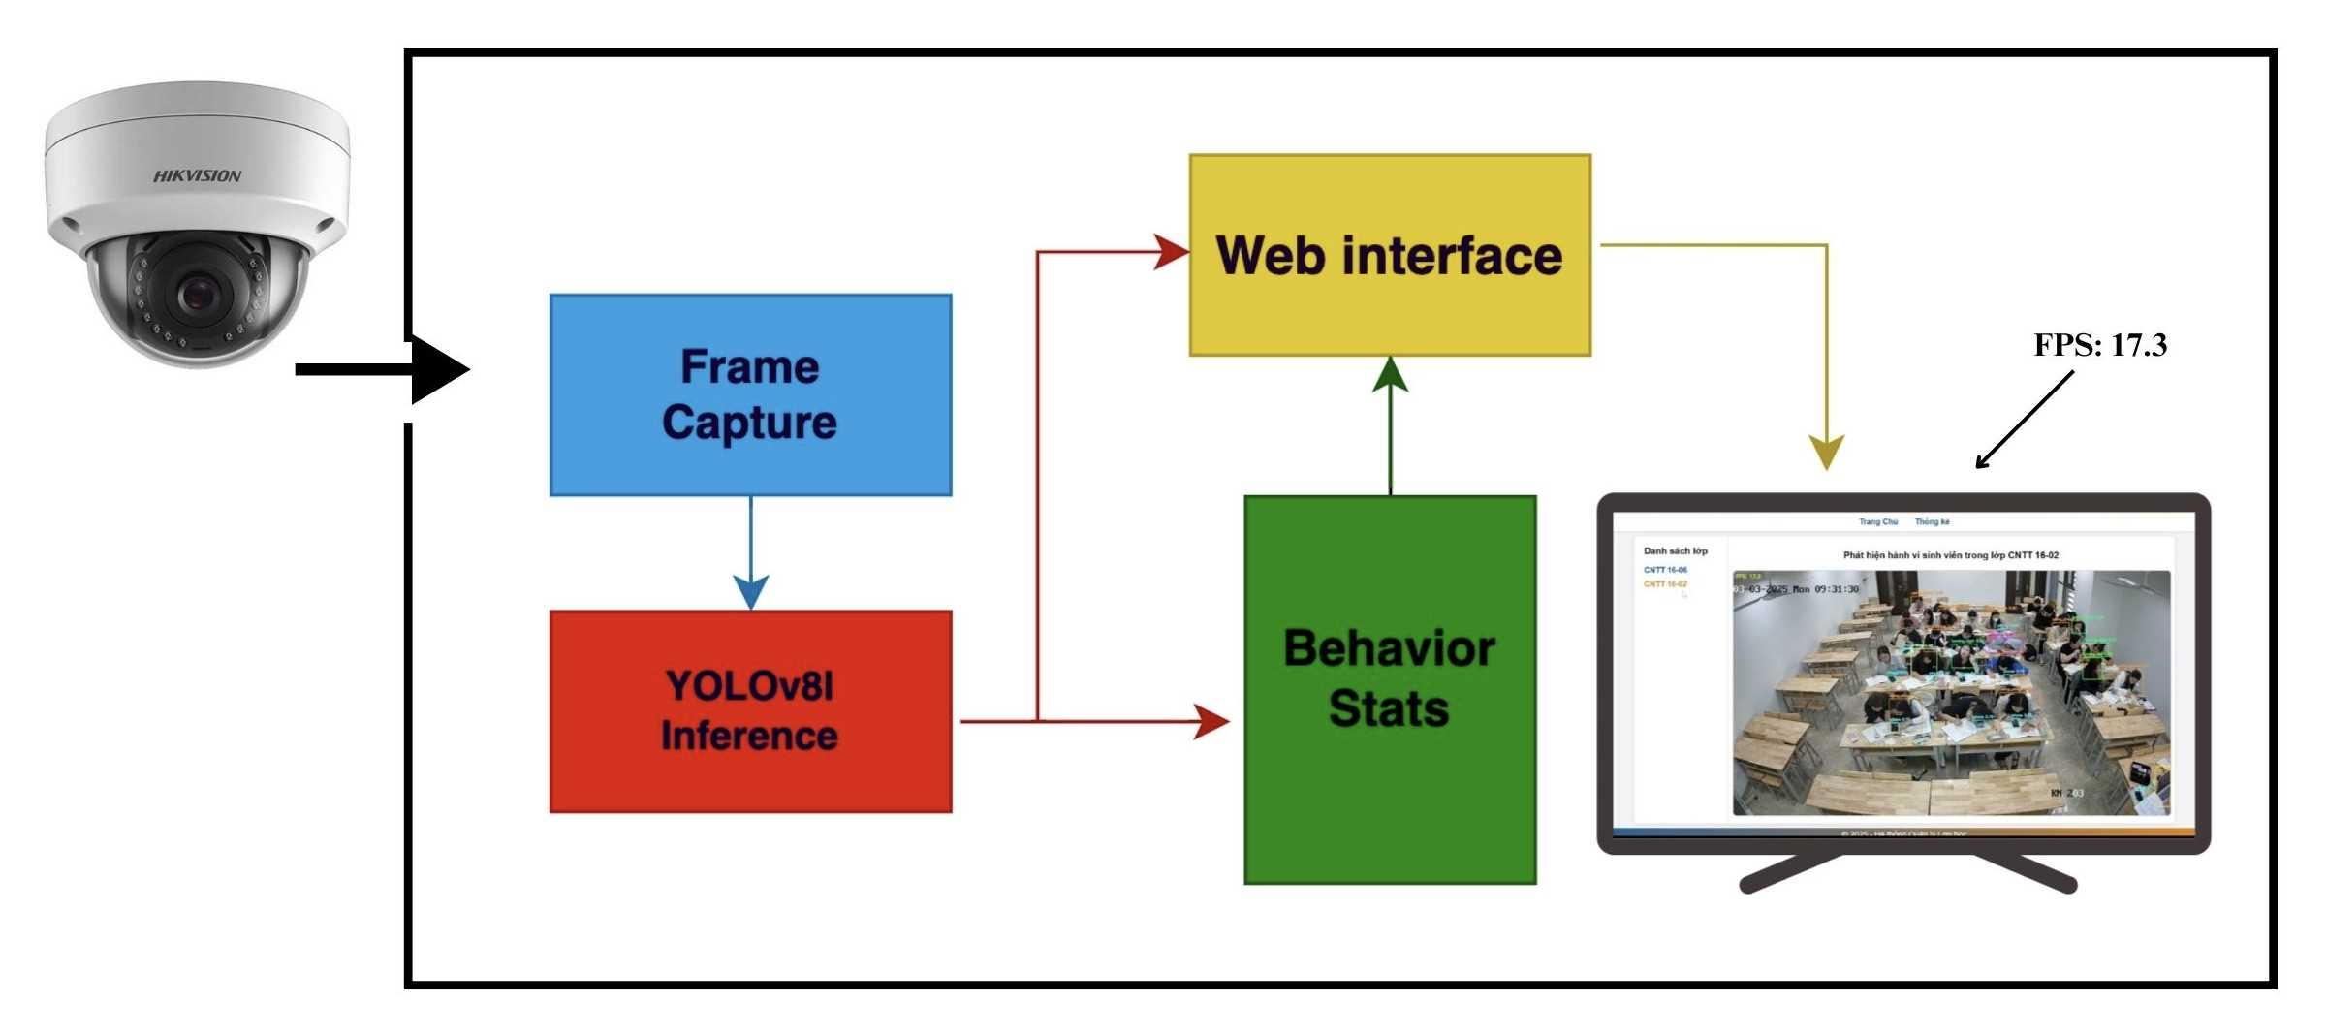
CÔNG TÁC ĐÁNH GIÁ THỰC TẬP
CONTRIBUTIONS
Real-time inference
YOLOv8l real-time deployment with ceiling mounted HIKVISION camera.
Multi-threaded pipeline: frame capture -> inference -> browser visualization.
Performance ~17 FPS on RTX GPU, robust for frequent behaviors.
Feasible for real classrooms without cloud dependency.

Slide 13
CÔNG TÁC ĐÁNH GIÁ THỰC TẬP
CONCLUSIONS AND FUTURE WORKS
Conclusions
Introduced the T-Students FITDNU dataset: real Vietnamese university classrooms with a single fixed camera.
9 annotated categories created via a semi-automated labeling process.
Among three YOLO models, YOLOv8l performed best, especially for subtle and small-scale behaviors.
Occluded actions remain challenging.
Future Works
Expand the dataset to more diverse classroom settings.
Apply Focal Loss to address class imbalance.
Shift from static detection to temporal recognition with sequence-based models for deeper insight into student engagement and smarter classroom monitoring.

Slide 14
CÔNG TÁC ĐÁNH GIÁ THỰC TẬP
REFRENCES
[1]. Fang, Chiung-Yao, et al. "Student gesture recognition system in classroom 2.0." 14th IASTED International Conference on Computers and Advanced Technology in Education, CATE. Vol. 2011. 2011.
[2]. Fu, Rong, et al. "Learning behavior analysis in classroom based on deep learning." 2019 Tenth International Conference on Intelligent Control and Information Processing (ICICIP). IEEE, 2019.
[3]. Zheng, Rui, Fei Jiang, and Ruimin Shen. "Intelligent student behavior analysis system for real classrooms." ICASSP 2020-2020 IEEE International Conference on Acoustics, Speech and Signal Processing (ICASSP). IEEE, 2020.
[4]. Abdallah, Taoufik Ben, Islam Elleuch, and Radhouane Guermazi. "Student behavior recognition in classroom using deep transfer learning with VGG-16." Procedia Computer Science 192 (2021): 951-960.
[5]. Tang, Longyu, et al. "Classroom behavior detection based on improved YOLOv5 algorithm combining multi-scale feature fusion and attention mechanism." Applied Sciences 12.13 (2022): 6790.
[6]. Nazaruddin, Mohamad Nazmi Zharfan, et al. "Utilising the YOLOv3 Algorithm for the Student Posture Recognition System in Classroom Settings." 2023 IEEE 8th International Conference on Recent Advances and Innovations in Engineering (ICRAIE). IEEE, 2023.
[7]. Jia, Qingzheng, and Jialiang He. "Student behavior recognition in classroom based on deep learning." Applied Sciences 14.17 (2024): 7981.
[8]. Han, Lisu, et al. "A WAD-YOLOv8-based method for classroom student behavior detection." Scientific Reports 15.1 (2025): 9655.
[9]. Liang, Weiqiang, et al. "A YOLO-based behavior detection and analysis system for smart classrooms." International Conference on Remote Sensing, Mapping, and Image Processing (RSMIP 2025). Vol. 13650. SPIE, 2025.
[10]. Peng, Shuyun, et al. "YOLO-CBD: Classroom Behavior Detection Method Based on Behavior Feature Extraction and Aggregation." Sensors 25.10 (2025): 3073.

Slide 15



